Slide 1
Part 8-
Great Basin
and
Plateau
Native Americans

Slide 2
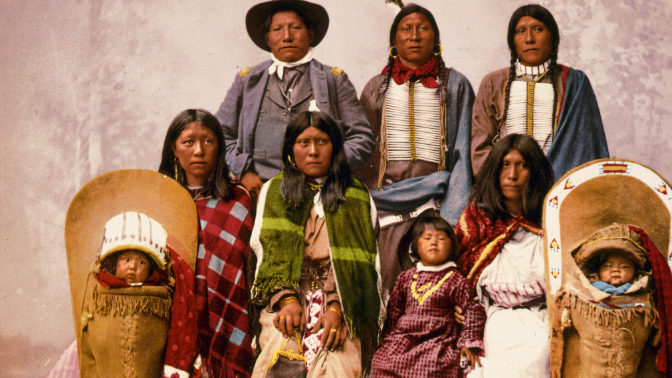
Great Basin Native Americans

Slide 3
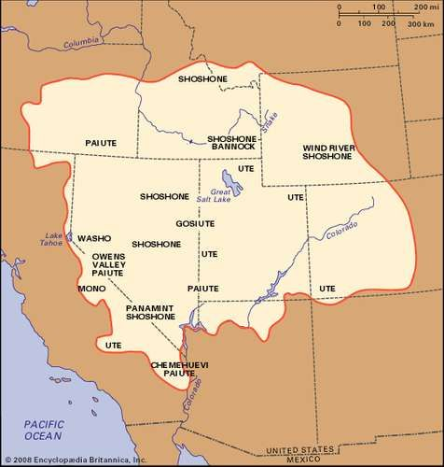
The Native Americans living in the Great Basin region occupied an area between the Rocky Mountains and the Sierra Nevada Mountains.

Slide 4
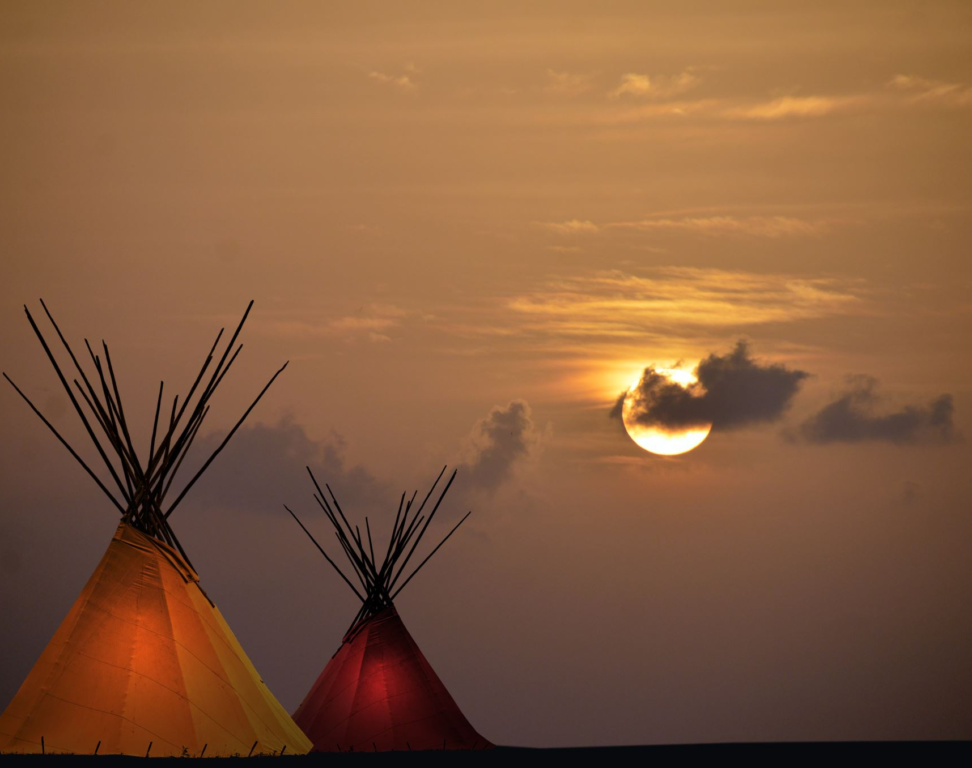
The people living in the different tribes lived a nomadic lifestyle, which means they moved around throughout the year in search of food.

Slide 5
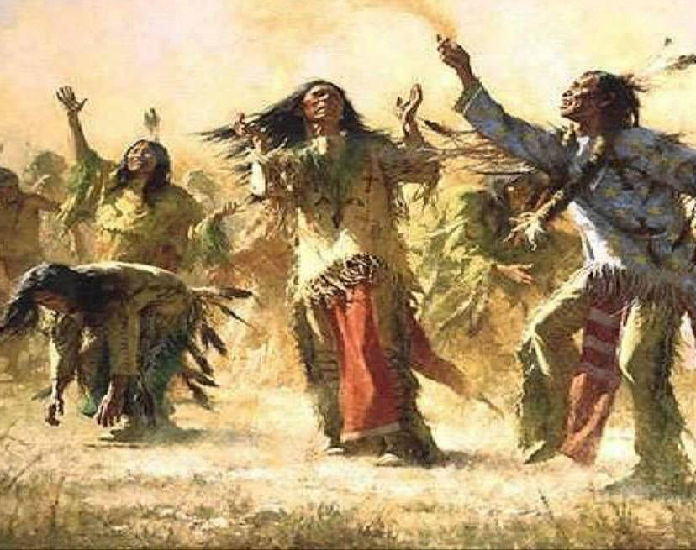
These Native Americans knew the land and the natural cycles well.

Slide 6
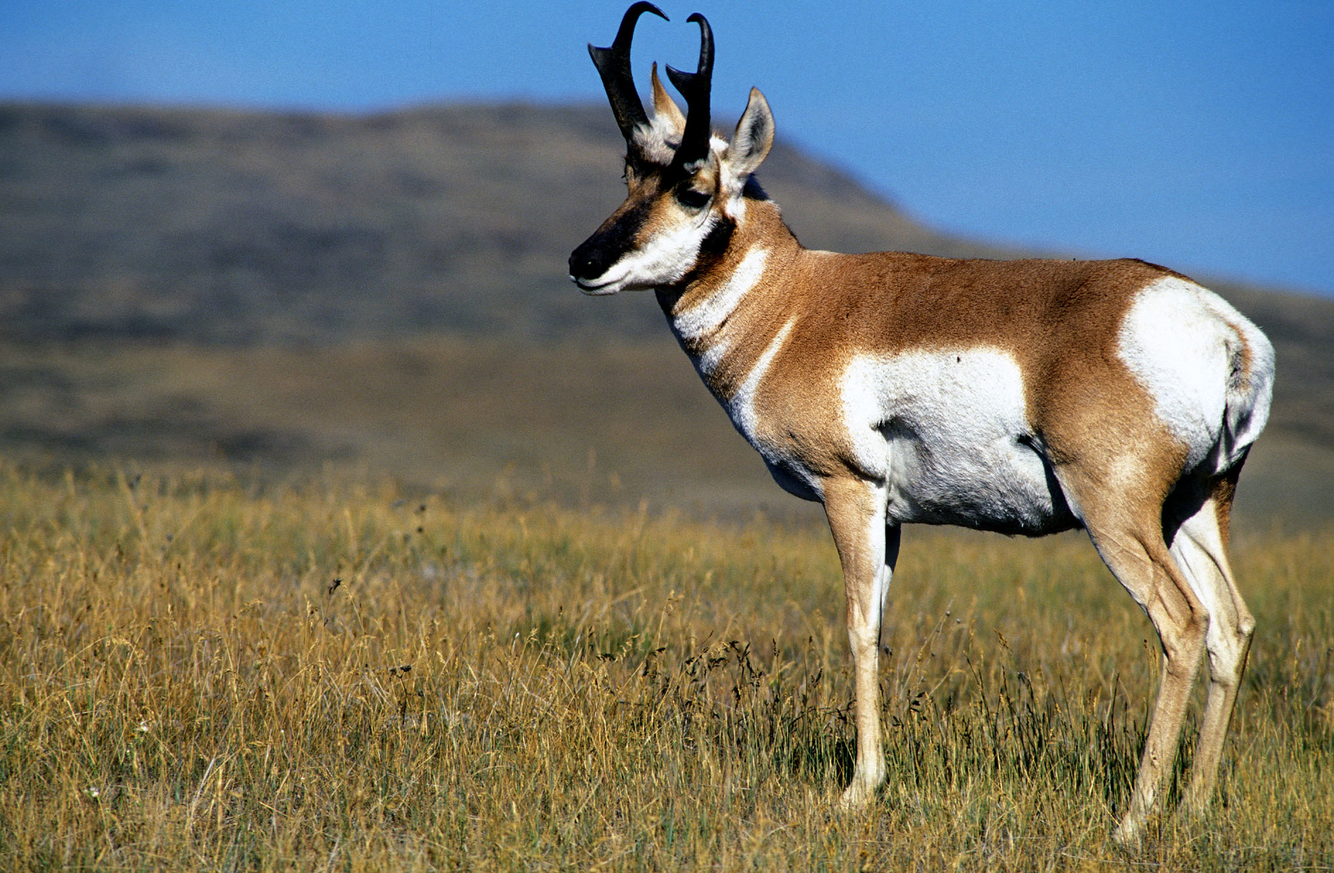
They hunted in small family groups for animals like jackrabbits, antelope, and waterfowl.

Slide 7
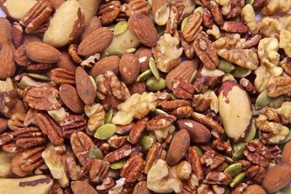
They gathered pine nuts and berries and dug roots and tubers. They also fished and farmed small areas of land where available.

Slide 8
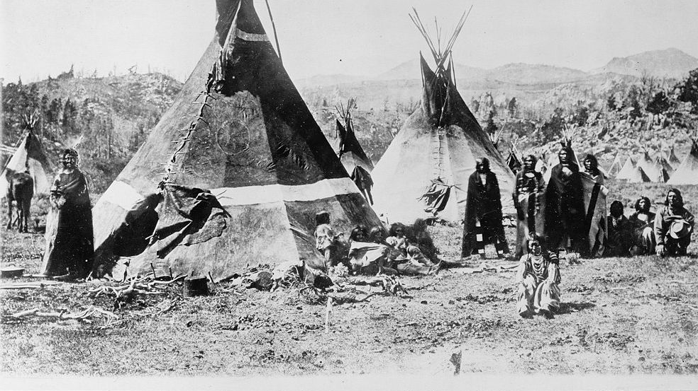
Many lived in Tipis and owned few possessions.

Slide 9
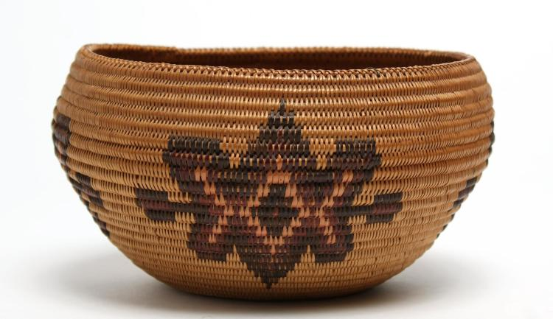
These Natives were excellent craftsmen, weaving decorative baskets, painting pottery, and making jewelry.

Slide 10
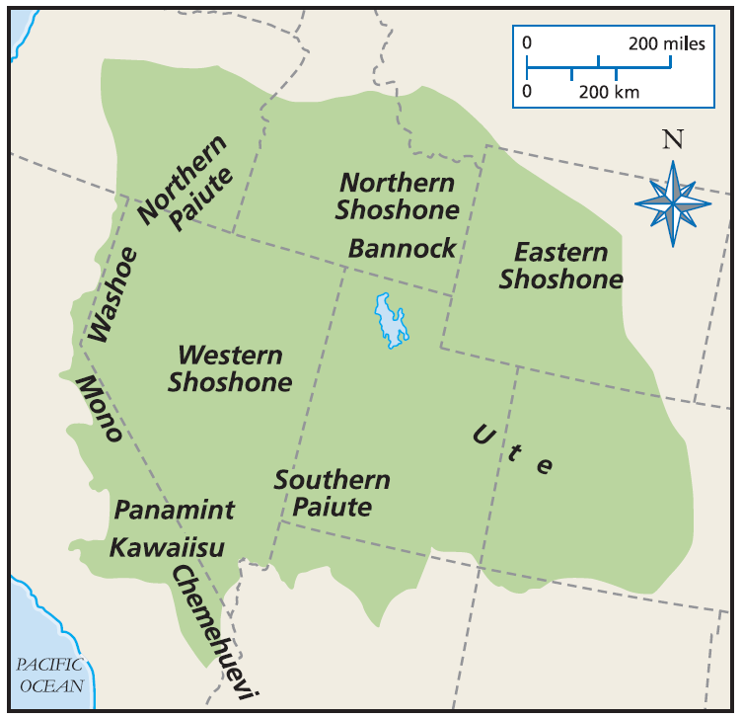
Some of the tribes that lived in this region were the Western Shoshone, the Ute, the Paiute, and the Washoe.

Slide 11
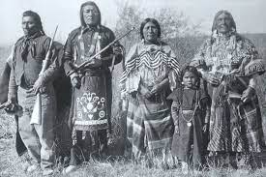
Many of these tribes spoke similar languages.

Slide 12
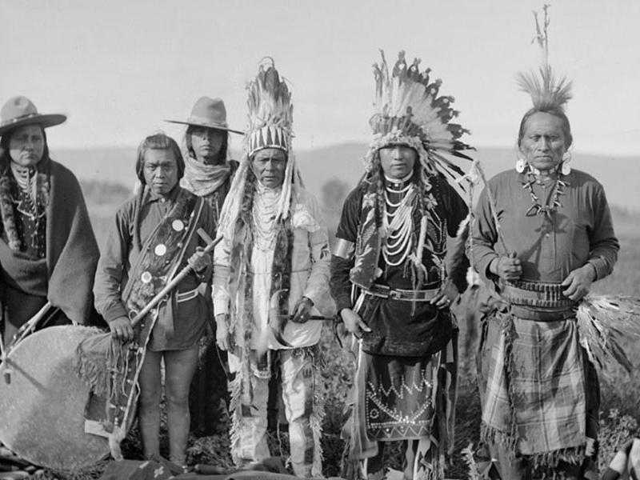
Plateau Native Americans

Slide 13
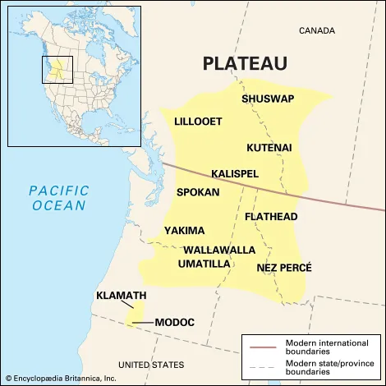
The Plateau Native Americans lived on the high plateau region between the Cascade Mountain Range and the Rocky Mountain Range.

Slide 14
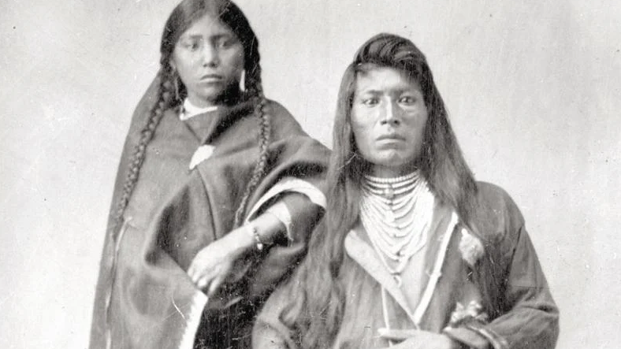
Some of these tribes include the Flathead, Spokane, Nez Perce, and Yakama.

Slide 15
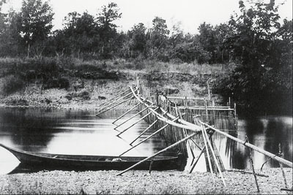
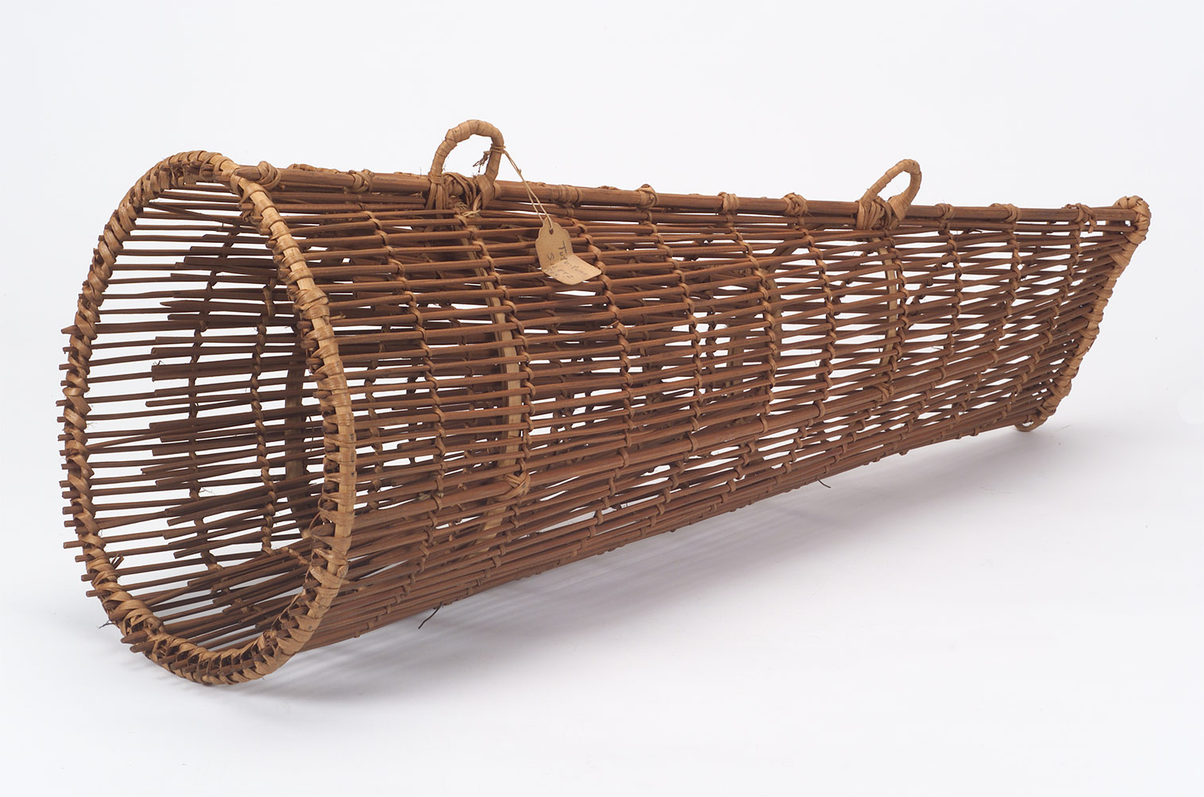
These Native Americans relied on wild foods. Fishing for salmon, trout, eel, and other fish were caught in the local rivers.

Slide 16
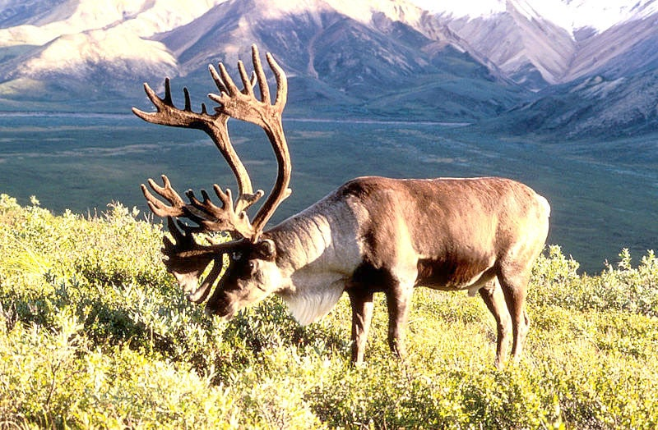
They also hunted for deer, elk, bear, caribou and small game.

Slide 17
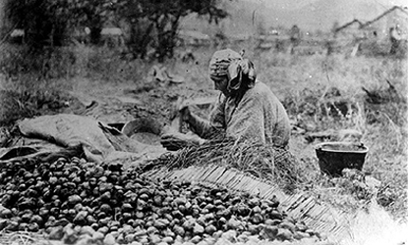
They also ate plants that they gathered like roots, bulbs, onions, and berries.

Slide 18
The Plateau Indians lived in permanent villages in the winter and more mobile villages or camps near good hunting spots during the rest of the year.

Slide 19
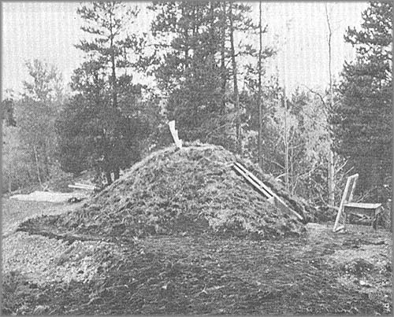
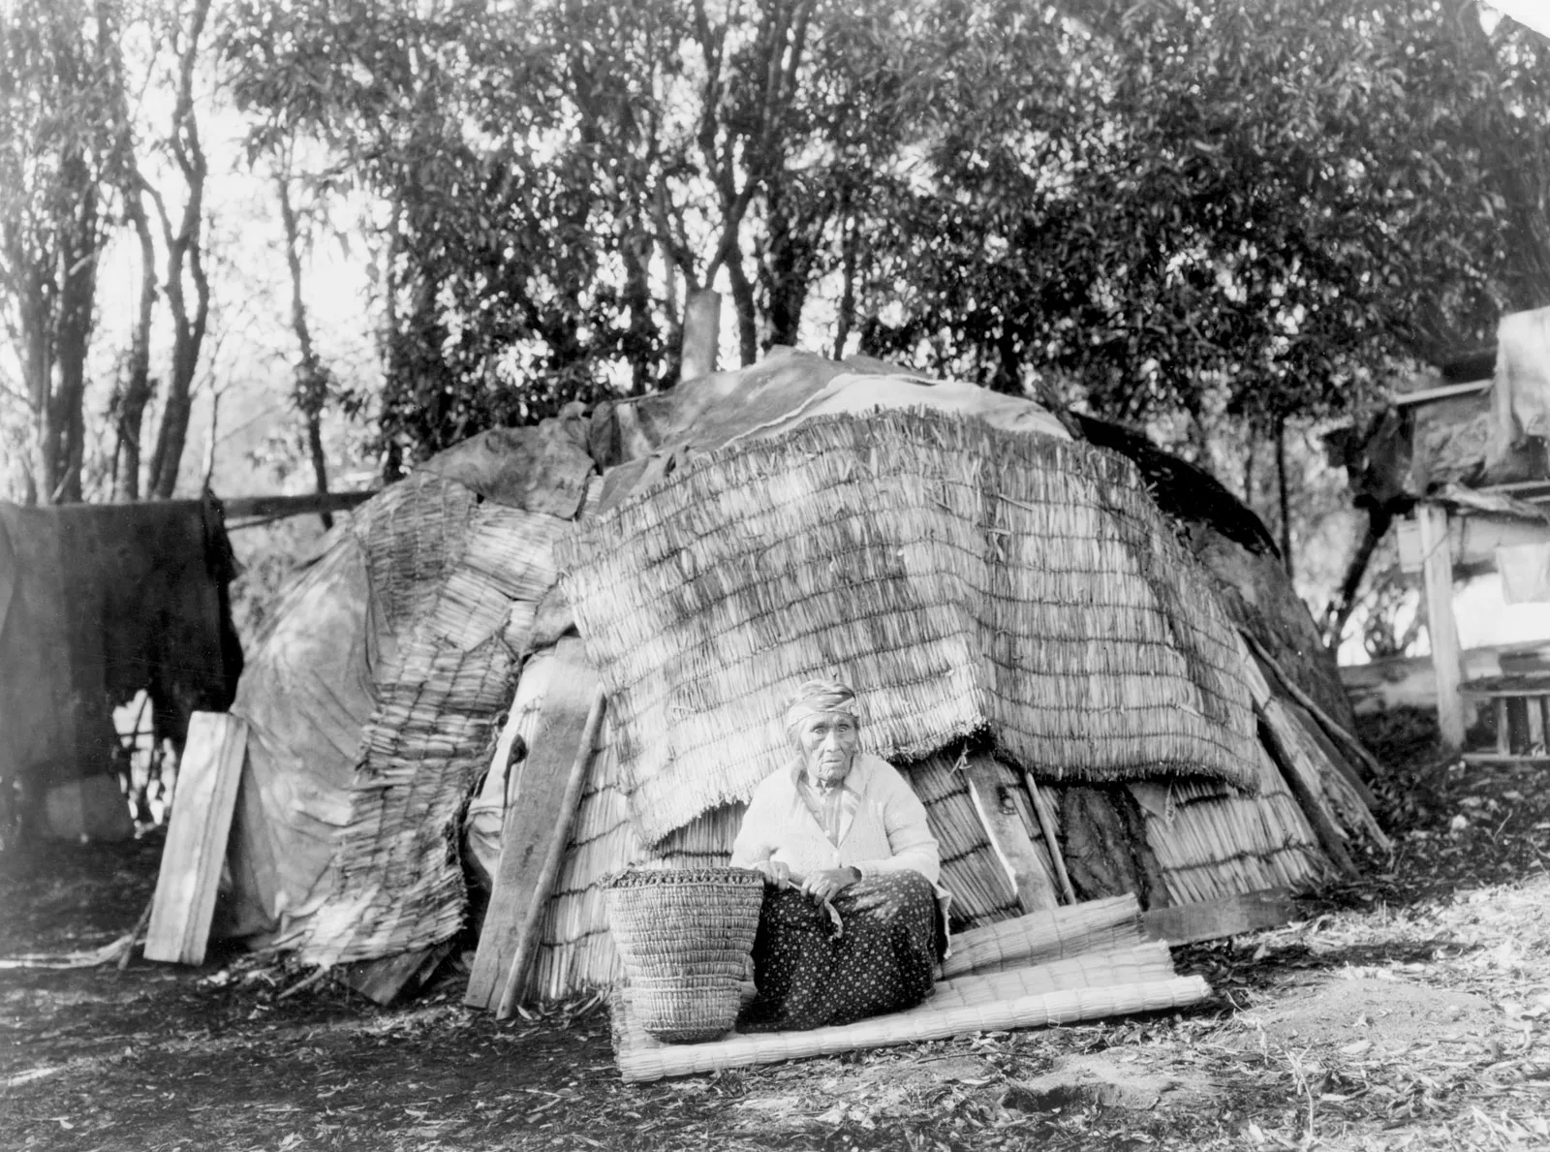
Their homes were usually one of two types, the pit house or the mat-covered house.
Video

Slide 20
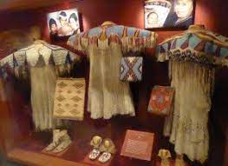
They wore bark breechcloths or bark ponchos. As time went on, they wore clothing made from leather and fur.

Slide 21
The Plateau Native Americans often traded with tribes from other regions like the Great Basin, Plains, California, and the Northwest Coast.

Slide 22
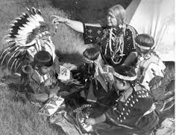
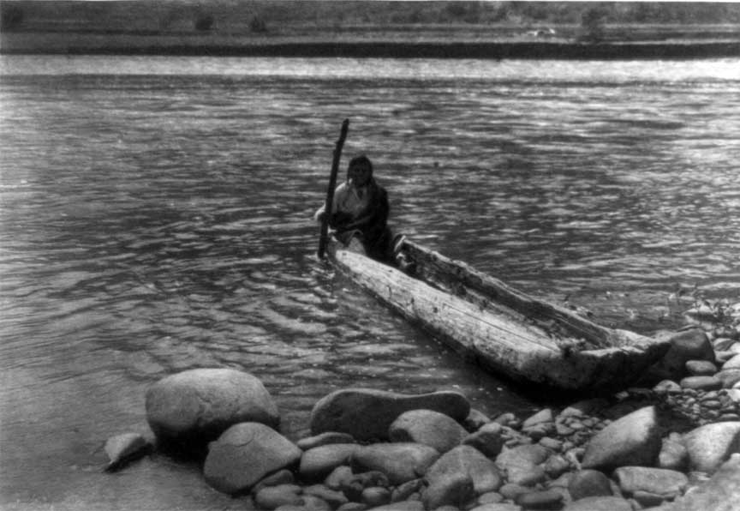
Plateau culture often emphasized the sharing of necessities like food resources and fishing and hunting sites.

Slide 23
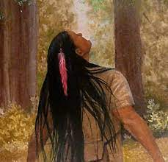
The Plateau Indians practiced animism as their religion and required vision quests for boys and recommended it for girls.

Slide 24
Exit Question
Why do you think the people living in the Great Basin and Plateau cultural areas were more nomadic than in other areas?

